Slide 1
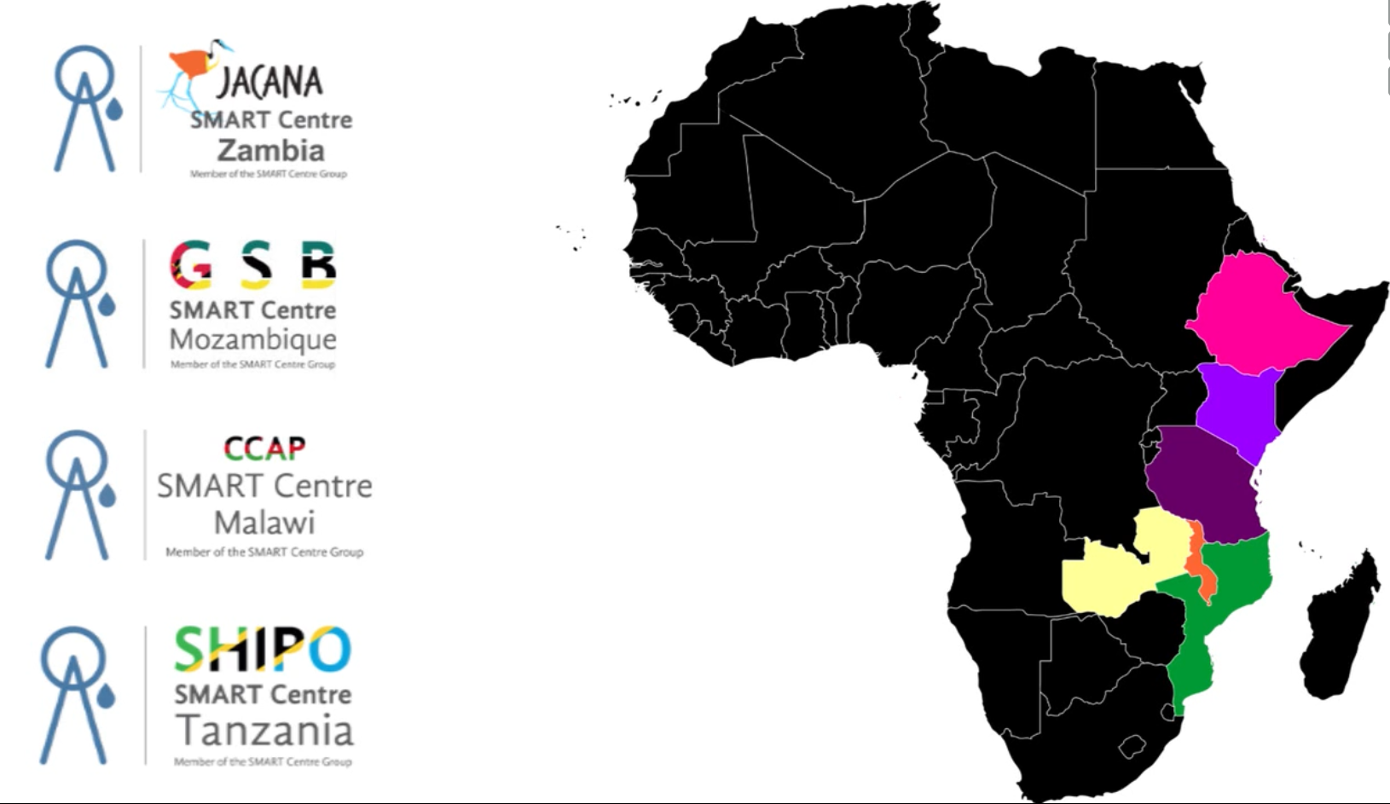
Training Entrepreneurs in Malawi in SMART Sanitation and Water Technologies
Reinier Veldman
Coordinator SMART Centre Group
www.smartcentregroup.com
www.smartcentremalawi.com
rveldman@metameta.nl
reinier@smartcentregroup.com

Slide 2
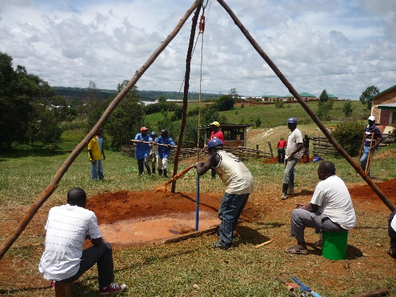
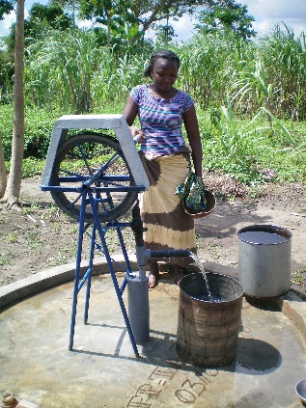
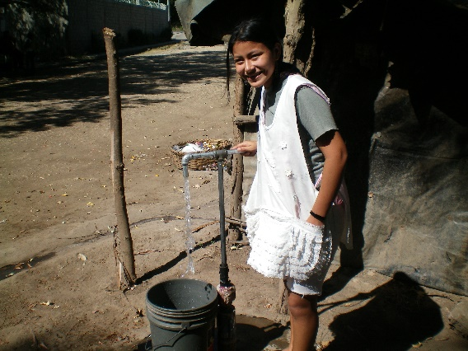
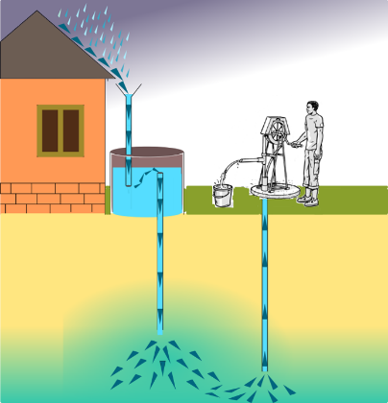
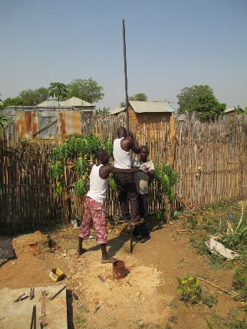
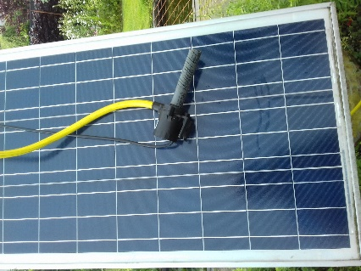
SMART Centres train private sector in:
Simple
Market-based
Affordable
Replicable / Repairable
Technologies
Choice of WASH technologies available for
Communities and housholds (Self-supply)

Slide 3
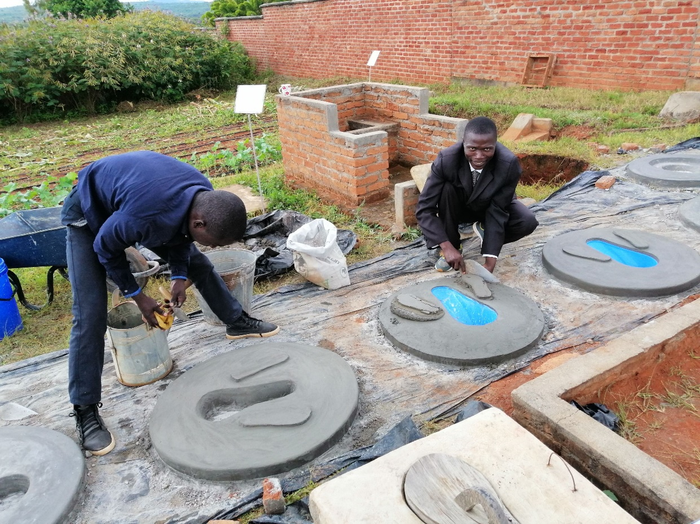
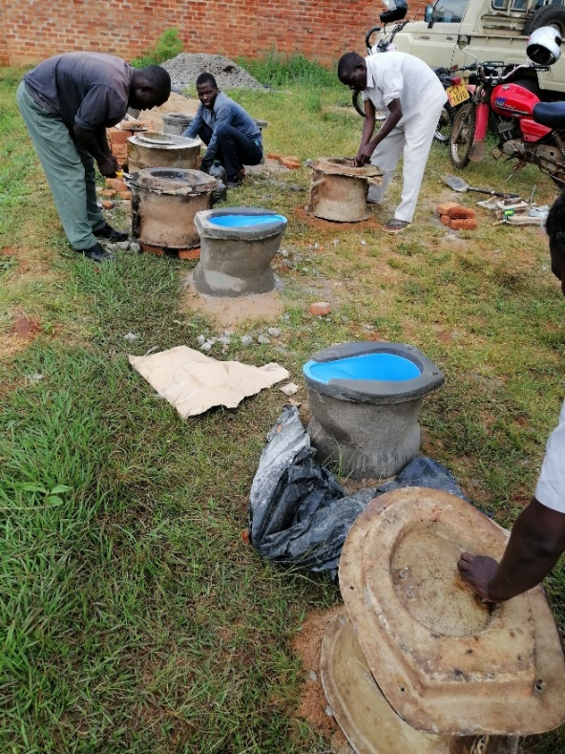
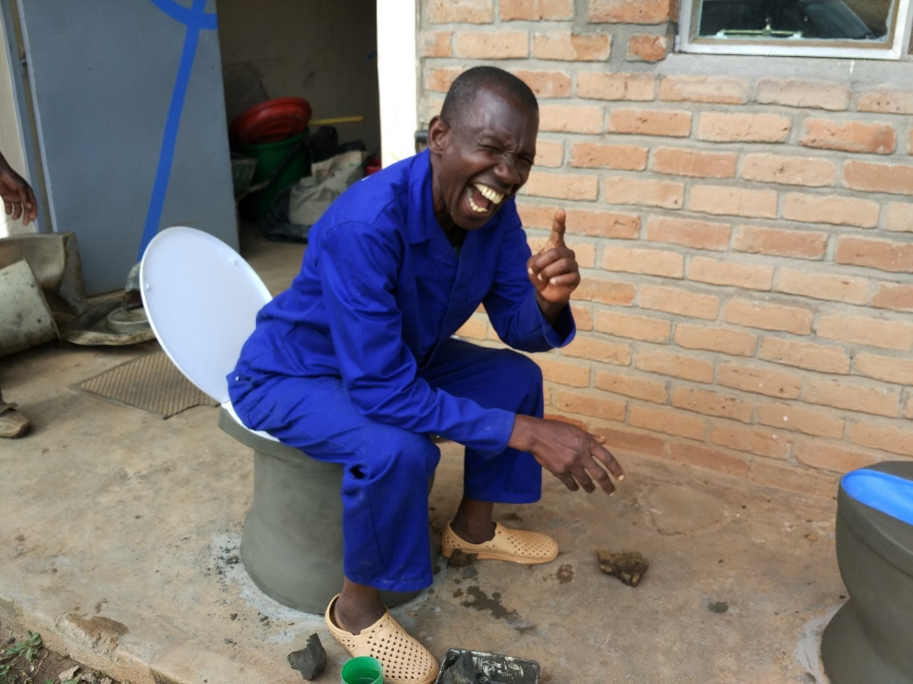
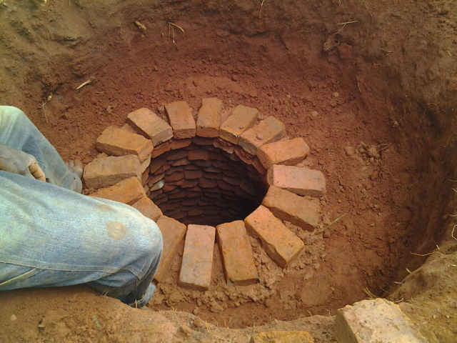
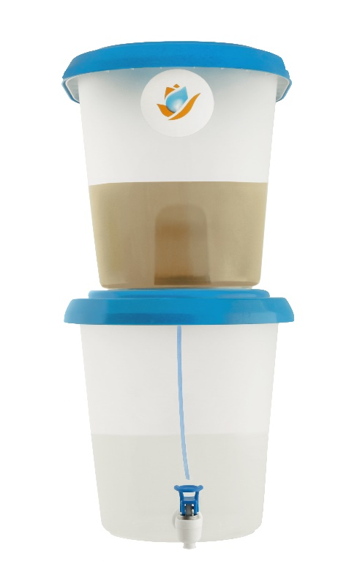
Sanitation products
Satopan / flapper
Cement pedestal
Corbelled latrine
Water filters

Slide 4
Challenges
Guarantee that entrepreneurs deliver quality
Finding ‘entrepreneurs’ with a business mind
Understanding of private sector by sector is limited
Questions
How to:
Reduce cost of Sanitation technologies?
Scale affordable Sanitation technologies?
Micro credits? Training programs? Certification? TVET’S?, ..

Slide 5
Thank you!

