Slide 1
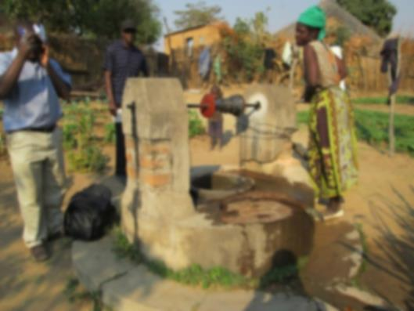
Socio-economic factors in Self-supply investment

Slide 2
Can only the richest have their own well?
Isn’t this a very inequitable solution?
Why make your own supply?

Slide 3
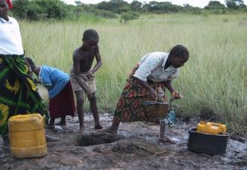
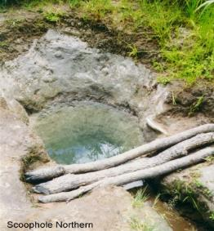
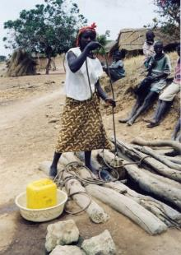
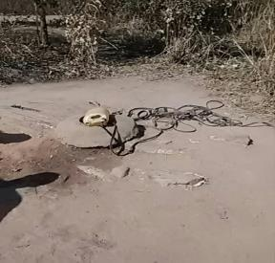
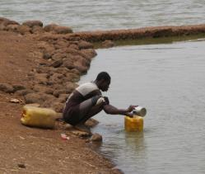
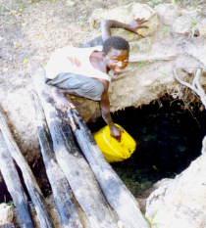
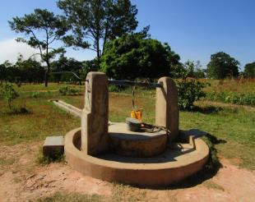
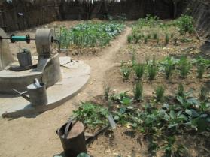
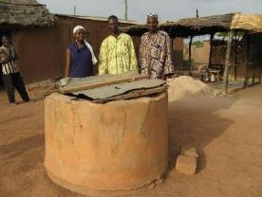
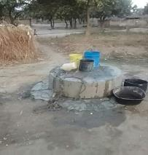
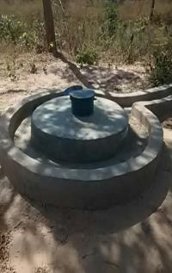
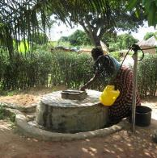
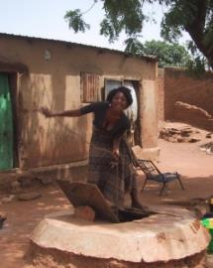
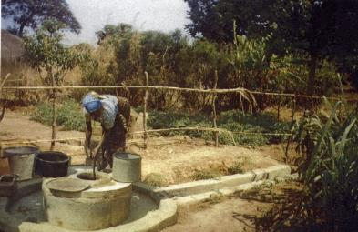
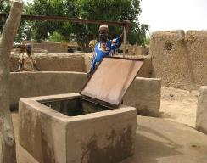
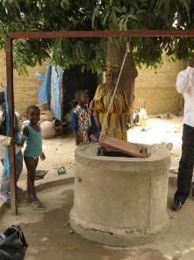
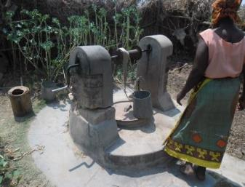
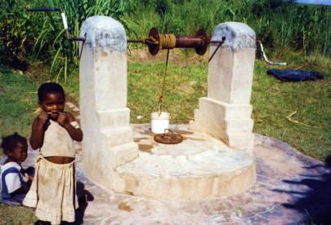

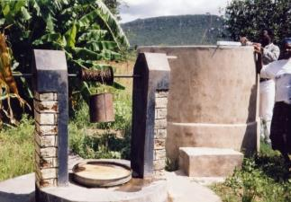
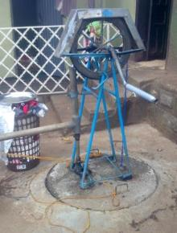
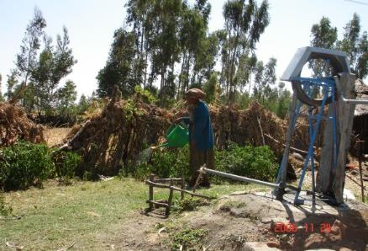
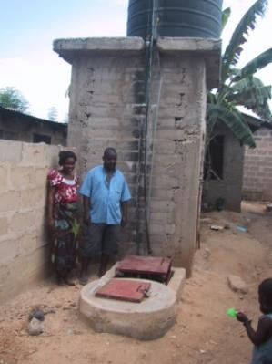
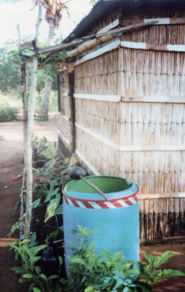
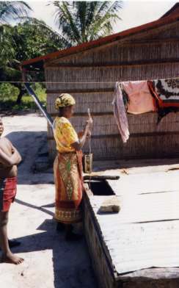
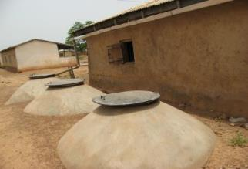
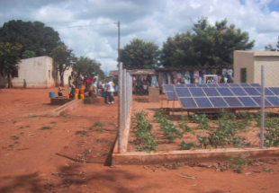
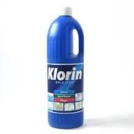
Can only the richest have their own well?
Isn’t this a very inequitable solution?
Why make your own supply?

Slide 4
Wealth and Equity in well -ownership
Owners
Sharers
ETHIOPIA
MALAWI
ZAMBIA
Total sample 1181 households

Slide 5
Sharing
“Water is life, there is
no need to deny others”
“How can I ask my cousin to pay me for what is free”
“Everyone has a right to water”
“I put my well near the edge of my plot so others can use it”
“Why would I deny my neighbour?”
Water is not a ‘commodity’ in rural areas, it is a communal asset even when privately owned
Notes:
Water is different from power, fuel, or agricultural produce. In rural areas in particular it is regarded as being ‘a common good’. Charging for it is rare unless it is lifted by motorised pump, or is in an area with piped water supply which is paid for.
Generally it is a social service provided by a family who gain status by sharing, and who can set rules for behaviour around the well. It provides a free supply to people who would otherwise have to walk much further and/or pay for water which may be too expensive for them to pay for on a regular basis.
Proportion of owners charging? Owners generally prefer to keep control and payment may weaken that.

Slide 6
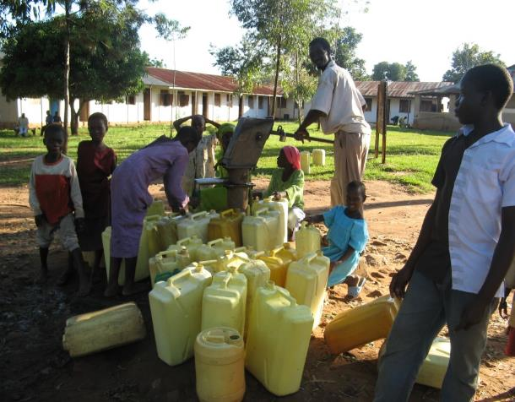
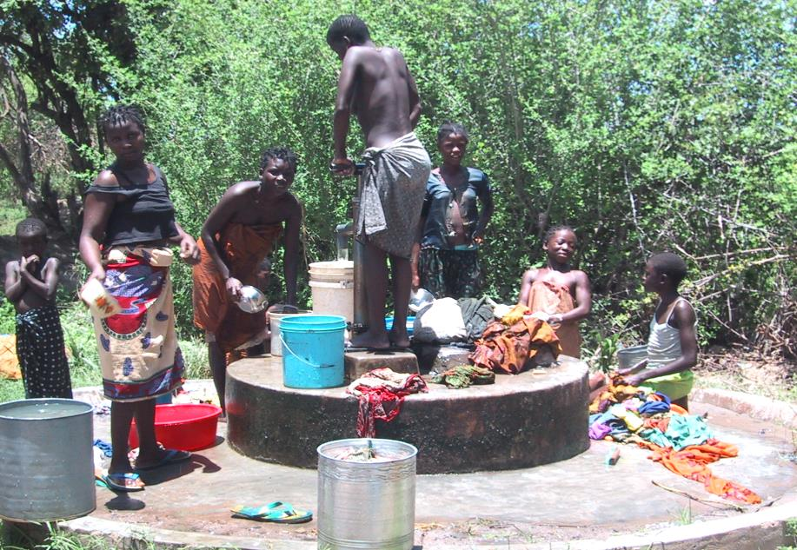
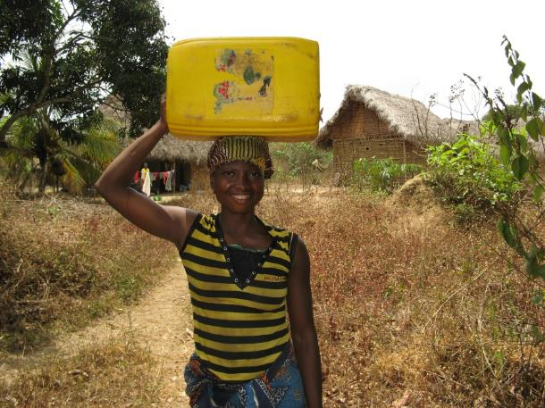
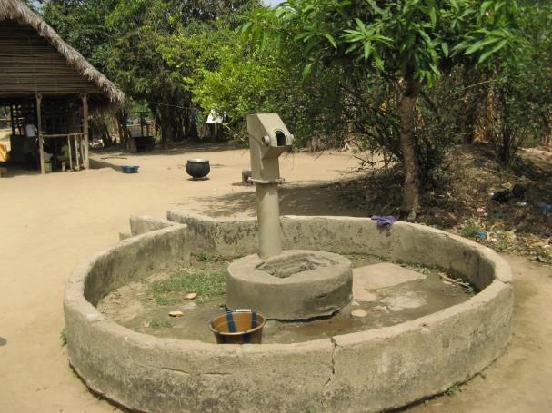
Push Factors
Long queues
Dirty habits of other users
Long tiring walks with heavy load
Breakdowns , temporary or permanent

Slide 7
Main pull-factors for household water supply
More family members can collect water, less burden on women
Less distance travelled and time taken to collect water
Less carrying of large volumes (more used on-site)
2. Less tiredness for women
6. More time available
More time for childcare and household
More energy and time for farming
1. Improved child health
3. Overall less family illness
Better school attendance and performance
Greater food security
Heightened status with a healthy well-fed family and a service to the community

Slide 8

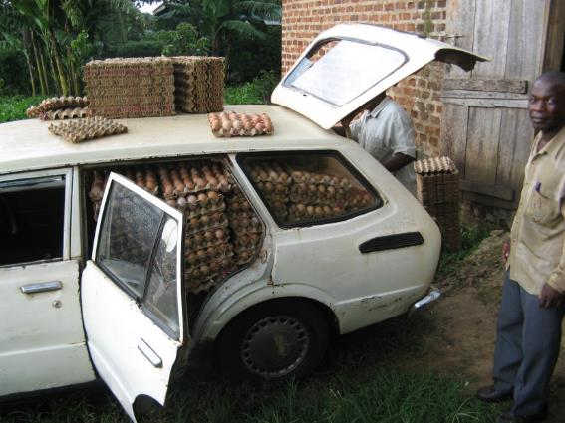
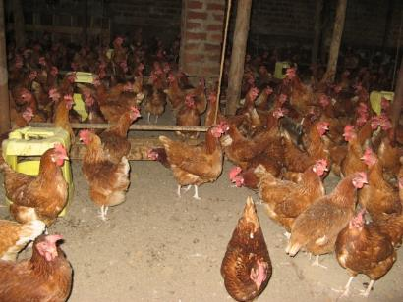
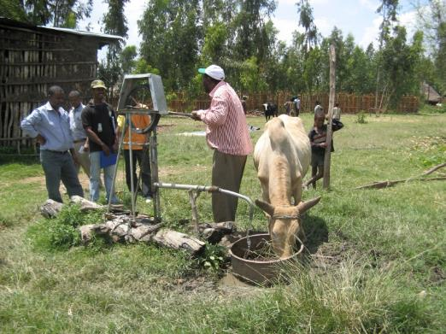
Other pull-factors
“I can use it for what I want, when I want, and where I want. It is on my own land”

Slide 9
Conclusions
Having your own water supply transforms quality of life in so many ways – needs further research
Most people invest in water supply initially for domestic uses and share it with others.
Obtaining direct economic benefit needs a change in mind-set at all levels, which takes time.
At least 250 million in SSA will be left unserved by any other supply in 2030. Wring your hands or offer alternatives?

Slide 10
Thank you!
References
UN Water 2017 UN-Water Global Analysis and Assessment of Sanitation and Drinking-Water (GLAAS) 2017 report. Financing universal water, sanitation and hygiene under the Sustainable Development Goals
Visit Rural Water Supply Network (RWSN) Website: http://www.rural-water-supply.net/en/self-supply

