Slide 1
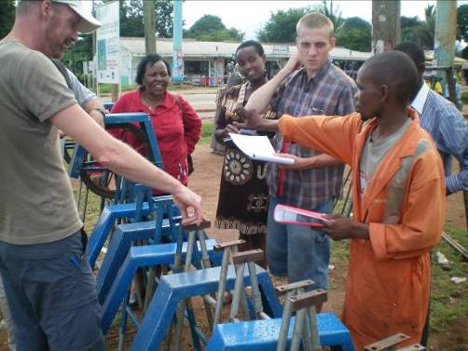
The SMART Centre Approach Training the Private Sector to Scale-up Self-supply through a Sustainable Business Model
Morten van Donk
Program & Management Advisor, SHIPO SMART Centre, Tanzania
Senior Advisor, SMART Centre Group, MetaMeta, The Netherlands
www.smartcentregroup.com
Notes:
My background (briefly).
Education in Agricultural development.
5 years experience with the SHIPO SMART Centre in rural Tanzania.
3 years in Zambia.
Recently working with the Dutch social enterprise MetaMeta to support the establishment of an umbrella for the SMART Centres.
This is not an academic study, but based on data collected over the last eight years and in particular through a study made by Annemarieke Maltha in November-December 2015 (refer to AM´s presentation on Wednesday).

Slide 2
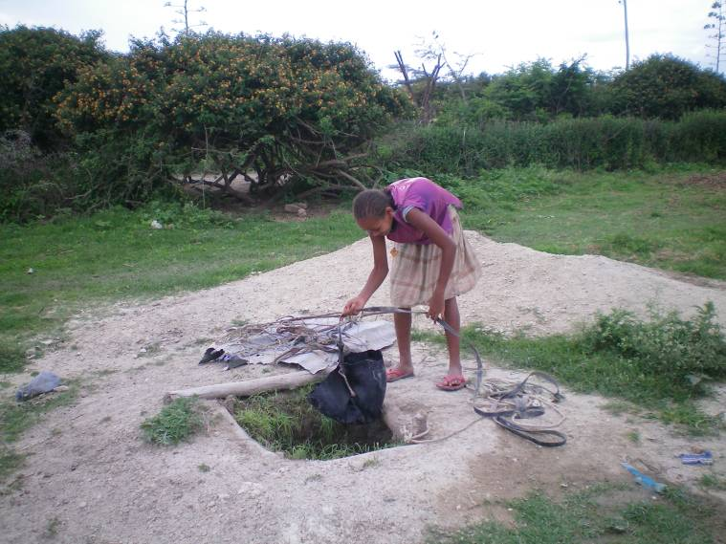
Challenge; reach SDG6
Reach ‘the Last Mile’ small remote, low density communities
Increase sustainability reduce cost, improve access to repair
Reach water related SDGs reduce rural poverty, safe water to all, increase food security. Via Self-supply.
Notes:
This is about:
How people that live beyond the reach of piped schemes may be supported to ”achieve access to safe and affordable drinking water” (SDG 6).
Is there a system for that?
Is there a sustainable system for that?
If no other support: they use Self-supply!
Self-supply as I see it:
Nothing you have to believe in or spent hours discussing. It is a way to describe things that are already happening.
And exactly that makes it a very strong concept to base a support in, because there is no discussion whether it is demand-driven or not! It is ONLY demand-driven (otherwise it will not happen)!
The question is HOW to support it, how to accelerate it, so more people can help themselves to safer water and sanitation (and we eventually reach SDG 6).
What are our options to support (accelerate) Self-supply?
How can we increase the options for Self-supply?
How can we reduce the costs of the available Self-supply options?
It is really a system to support (accelerate) Self-supply that we are looking for. I am not here to promote a certain pump type or a certain technology. We have access to a lot of data on pump functionality, etc. But one thing is for sure: EVERY pump will break down or need maintenance sooner or later. The question is ”What do people do when it (a pump, latrine, etc.) breaks down or needs maintenance?”, ”how can the consumer sustainably pay and organise repair?”

Slide 3
A solution; The SMART Centre approach
Simple, Market based, Affordable, Repairable Technologies
To increase Self-supply options, SMART Centres focus on;
Innovation Introduce, test and demonstrate technologies and approaches
Capacity building in private sector Train the local private sector in technology and business skills and build up supply chains for SMARTechs
Advocacy . Promote Self-supply among corporations, organisations and government. Ask for clear regulations and policies.
Notes:
One way to support (accelerate) Self-supply is the SMART Centre approach.
For those who think of phones or tablets when they hear the word SMART, I can say that it stands for Simple, Market-based, Affordable and Repairable Technologies.
Not necessarily a better approach than other approaches presented here at the Forum. But it is beginning to look like a well-tested and proven approach and it has had a number f good results in many other countries over the last more than 10 years.
Based on this we can share, discuss and learn.
So, what does a SMART Centre do?
Read bullet points
Advocacy: Ask for clear regulations and policies that benefit the unserved population

Slide 4
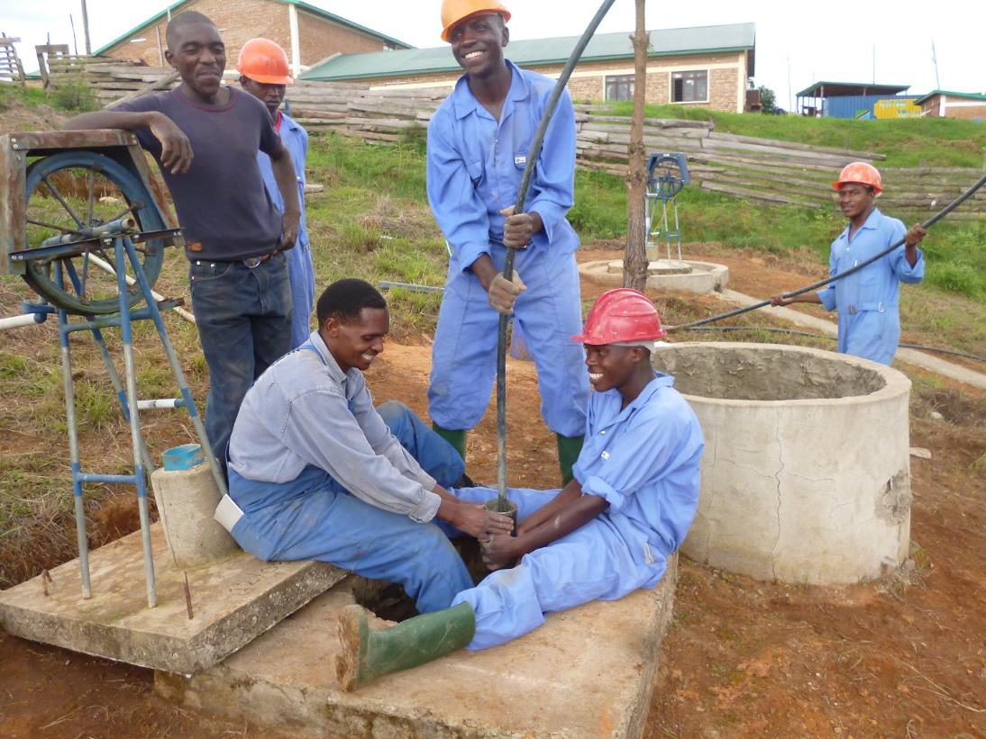
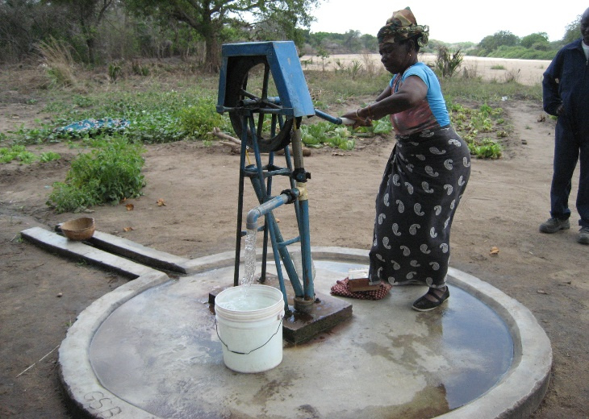
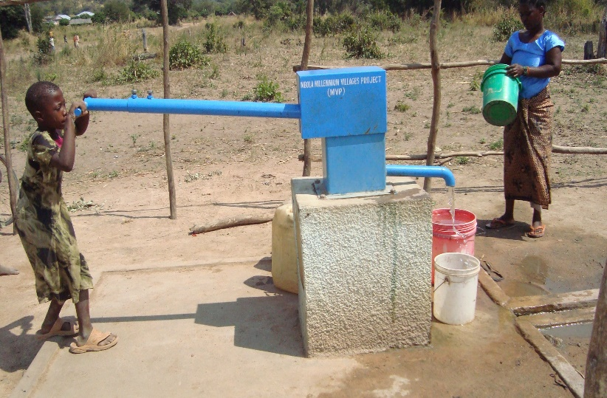
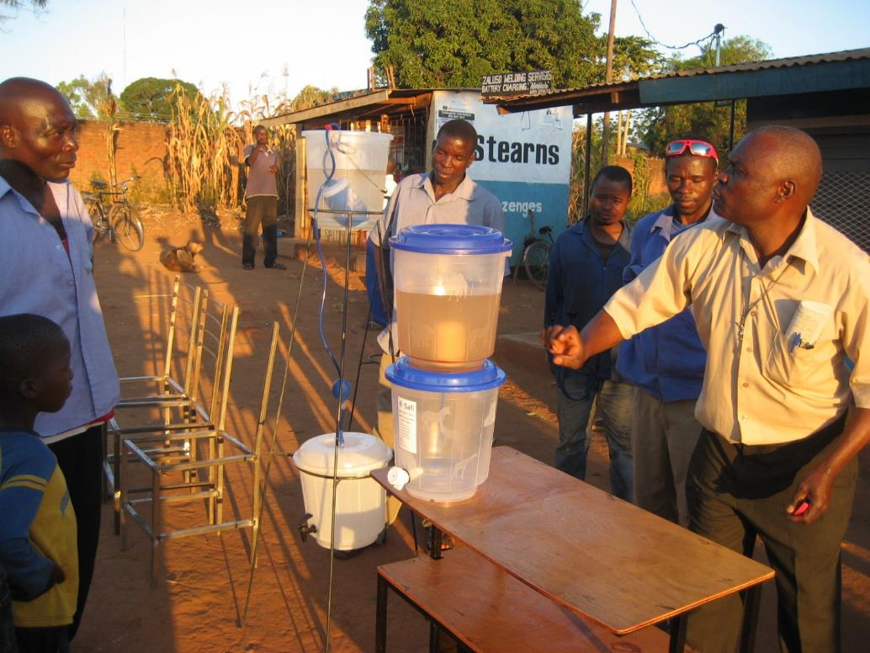
Examples of SMARTechs
Notes:
These are examples of SMARTechs. You will see more as Rik Haanen presents after me.

Slide 5
Results of the SC approach
Cost reduction of communal rural water supply to an average of 20 Euro /cap.
Increased options for Self-supply (and communal)
Building profit based sustainability in the supply chain; the local private sector stays after a projects stops
Going towards financial self-sustaining SMART Centres
SMART centre guarantees quality to larger clients
Government training centres start SMARTech training
Highly scalable to other areas and other countries
Notes:
General results, seen in various countries.
About the financial self-sustainnig SMART Centre:
SMART Centres are also heading towards financial sustainability.
Offering training and ”bulk selling” of SMARTechs to NGO’s, government institutions and private sector.

Slide 6
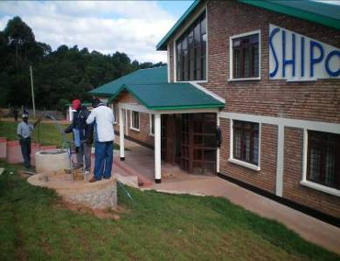
SC approach in Tanzania
20 new WASH technologies
35 private companies selling SMARTechs
VETA offers rope pump manufacturing course
MFI options tested for suppliers and consumers
Cost reduction of communal supply 40 to 15 $/cap
5,000 Rope pumps for communities paid by NGOs
5,000 Rope pumps for families paid for by families
Communal supply created the critical mass before Self-supply took off
Notes:
Take Tanzania as example as I know about it. Others can answer for other countries.

Slide 7
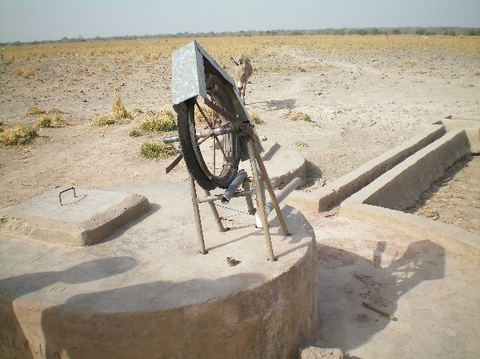
Challenges
Training the private sector requires long term follow up (expensive).
Collecting data after training. Monitoring things which are no longer our business! (scattered data)
To guarantee quality, certification of entrepreneurs is needed. Slow process and should be done by an officially recognized institution
Large scale-up still needs funding support. Through individual SMART Centres or SMART Centre Group

Slide 8
Established in 2015 to exchange knowledge and scale up the interventions of the SMART Centres by offering services to investors, donors and other clients.
Notes:
A note on the SMART Centre Group?
SMART Centres (very different setups) in more than 5 countries now. Communicating with 8 other countries for becoming part of the Group.
All have new ideas on technologies and services that they pour into the group, so others can use them.
Coordinated by MetaMeta (The Netherlands).
Characteristics of a SMART Centre:
Is hosted by a local organisation in the country of operation
Has a portfolio of SMARTechs that answers the demand in the country of operation
Tests and demonstrates SMARTechs
Identifies, selects and trains existing private sector
Uses logo and branding that relates to that of the SMART Centre Group
Collects and analyses minimum agreed indicators and deliver data to the SMART Centre Group annually and upon request.
Cooperates openly with other SMART Centres
Earns an income and fundraises independently or through the host organisation and is not terminally dependent on funding from SMART Centre Group.

Slide 9
Conclusions
To reach the SDG6 and ”the Last Mile” require innovative technologies and a focus on Self-supply
The SMART Centre approach creates sustainable businesses and a good base for Self-supply. Products are market-based and companies go on without further support.
The SMART Centre Approach is proving to work for more than 10 years and now in 4 countries.
The SMART Centres are financially self-sustaining at current level but need external funding for scaling up interventions.
Scaling up the SMART Centre approach will drastically assist in reaching the SDG6
Notes:
Introducing affordable, market-based technologies made from locally available material and that can be maintained locally for only little cash – is one way to support the people living beyond reach of a piped scheme.
- There is a system for that. The result is sustainable, but to scale it considerably up with large impact before 2030, external support is needed

Slide 10
Questions and discussion

