Slide 1
Impact of SMART Centres to accelerate Self-supply in rural water services - an example from Tanzania -
Annemarieke Maltha and Morten van Donk
www.smartcentregroup.com
Notes:
Affiliation de l’intervenant = organisation que l’intervenant représente

Slide 2
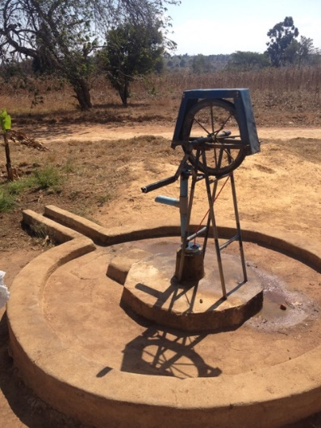
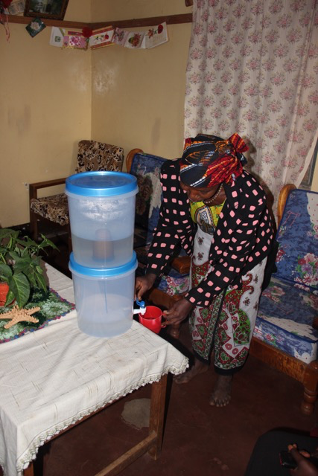
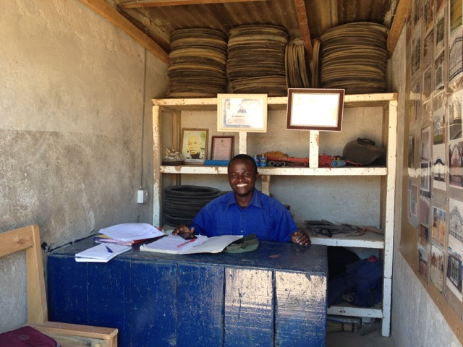
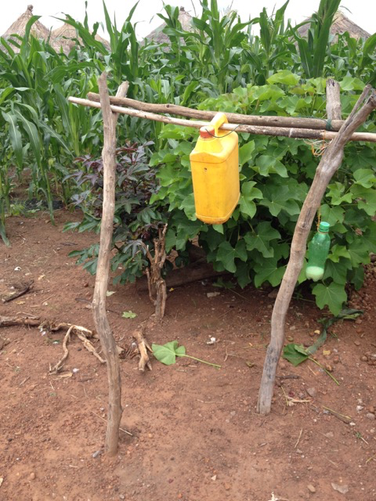
Objective
Reach sustainable water supply in Tanzania also in small communities or at family level where machine-drilled boreholes are too expensive
Create supply chains of options that are also affordable at family level, for Self-supply, in general technologies produced and sold by local private sector

Slide 3
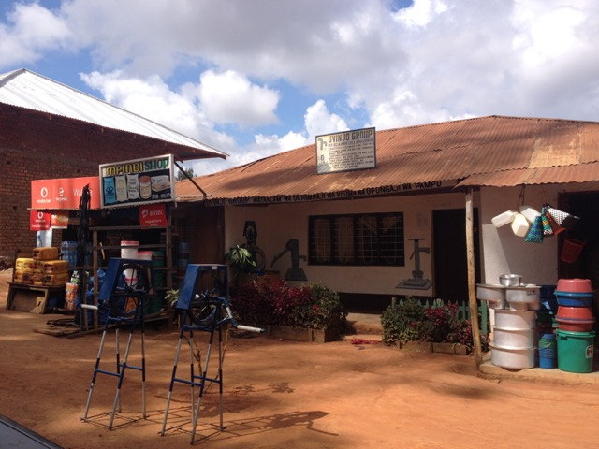
SMART Centre approach Simple, Market-based, Affordable, Repairable Technologies
SHIPO SMART Centre Tanzania since 2003
Training and knowledge transfer of around 20 SMARTechs
35 succesful entrepreneurs producing and selling quality products
10.000 installed Rope pumps: 5000 for Communal supply and 5000 for Self-supply in rural and peri-urban areas
Can Self-supply help to reach
the goal of access for all?
A case study on Self-supply
Notes:
Distribution by NGOs or by entrepreneurs (supply chain)

Slide 4
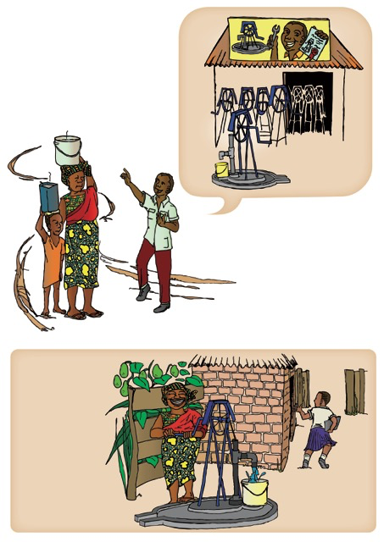
Case study on Self-supply
Assessment of the supply chain
Businesses, entrepreneurs
Technologies fit for Self-supply,SMART wells and pumps
Motivations and needs of Self-supply water users
What are the challenges to accelerate scale-up?

Slide 5
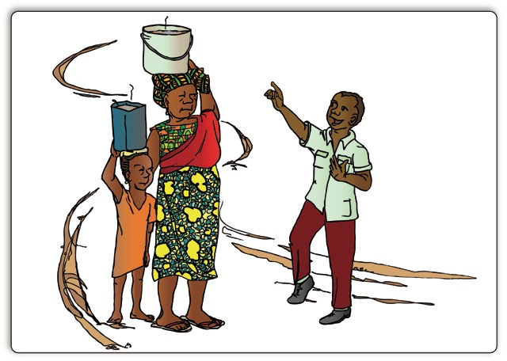
The entrepreneur (1)
His customers are
NGOs buy drilled wells / pumps for (subsidised) rural communal supply
Families. Rope pumps for Communal supply created market for Self-supply which now is 60% of the sales already (1) Peri urban families who have communal supply invest in a well and pump. Families see neighbors with a Rope pump and follow
(2) Rural families, less money, buy a pump between 2 or 3 families
Rope pumps and wells) increased market for entrepreneurs. Results, income, jobs
Supply chain of materials relatively well developed, bulk supplies from Dar es Salaam

Slide 6
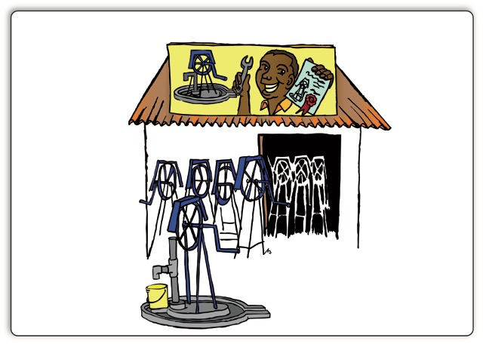
The entrepreneur (2)
Marketing is bottom-up: Satisfied users is the best marketing, a critical mass does the rest
Limitations to scale up
Limited business skills/ marketing skills
No strategy how to grow, approach new customers
Few companies doing very well
Insufficient capital prohibits smaller companies to grow
Notes:
Growth strategy: expand customer base with existing and new products, open branch office, invest in equipment

Slide 7
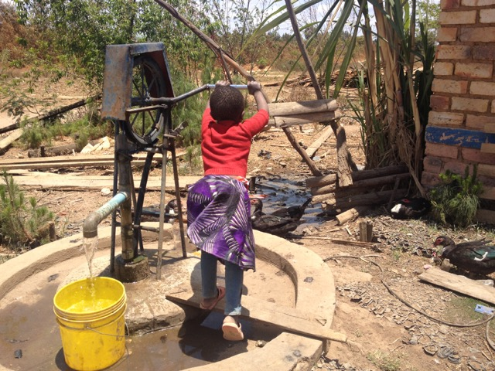
The water user (Self-supply)
80% of the pumps for Self-supply sold to semi-urban families, middle class and top of BoP (teachers, shop owners, company owners, larger farmers)
95% of the families paid upfront, 5% via microcredit (SACCOS)
Sales via examples at neighbours, health clinics, demonstration models at entrepreneur
Notes:
Which type of water user chooses for Self-supply?
How do they make the choice?

Slide 8
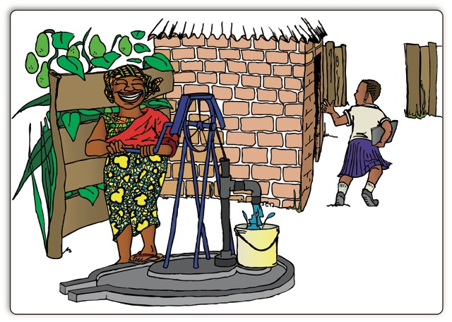
Motivation to invest in Self-supply
Convenience; reliable water source nearby
Independency from neighbours
Avoid waiting time at communal water supply
Communal water supply, piped system often not functioning
New pumps, Rope pumps are simple and much more affordable than conventional
piston pumps.
Good for production (Irrigation, watering animals, car wash)
Notes:
Reasons to invest in a well and Rope pump
Additional annual income: 90 to 1350 USD
Domestic and productive use (chicken farm, water sales, construction, gardening, avocado trees, milling, etc.)

Slide 9
Sustainability of Self-supply
Maintenance costs of Rope pumps were few and affordable
92% of the private wells / Rope pumps were functional at date of interview
Users did small repairs themselves (ownership), spare parts for Rope pumps were easily available.
Up to 35 households used 1 family pump. Water was mostly provided for free to other HH
Pumps sold by local companies, no interference of NGOs

Slide 10
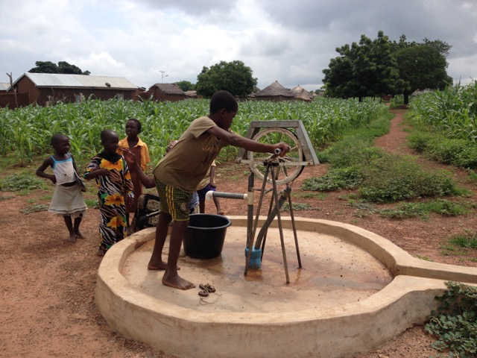
Conclusions/ Recommendations
Accelerate scaling up of rural water supply with low cost technologies possible via a market-based approach with actions;
Create a critical mass in new areas
Expand training entrepreneurs, Include training in Vocational education
Provide long term follow up on quality, technical and business skills
Facilitate entrepreneurs in access to capital, social marketing
Awareness, Show families economic benefits and convenience of Self-supply
Add other inclusive business models to enable Self-supply for poorer HH
Notes:
Add other inclusive business models, such as financial support solutions, lower cost pump models, partial funding, to enable Self-supply for poorer HH

Slide 11
With thanks to
All interviewed entrepreneurs and water users, Morten van Donk, Henk Holtslag, Eelco van der Pal, Eugenia Kimaro, Andre Olschewksi,Nanda Buis and SHIPO SMART Centre

