Slide 1
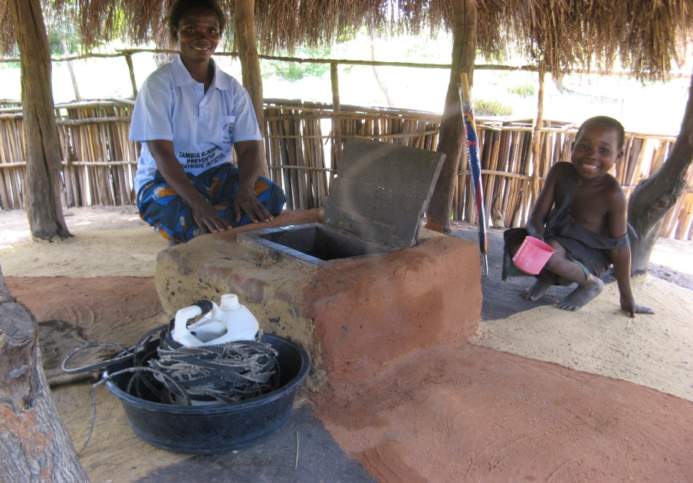
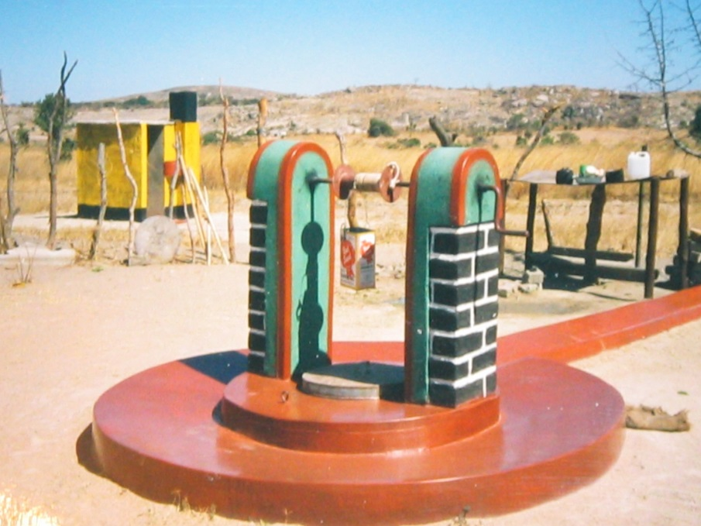
Making Universal Access to Water Affordable in Zambia and Zimbabwe
Dr. Sally Sutton
Independent Consultant
Dr. Peter Harvey
UNICEF

Slide 2
To reach universal access to water in Zambia and Zimbabwe the rate of progress in rural water supply needs to accelerate by almost six times!
Example: current coverage in rural Zambia is 51% (and 67% in Zimbabwe) and we need to provide access to improved water to 8.2 million more rural people by 2030 (6.8 million in Zimbabwe).
2

Slide 3
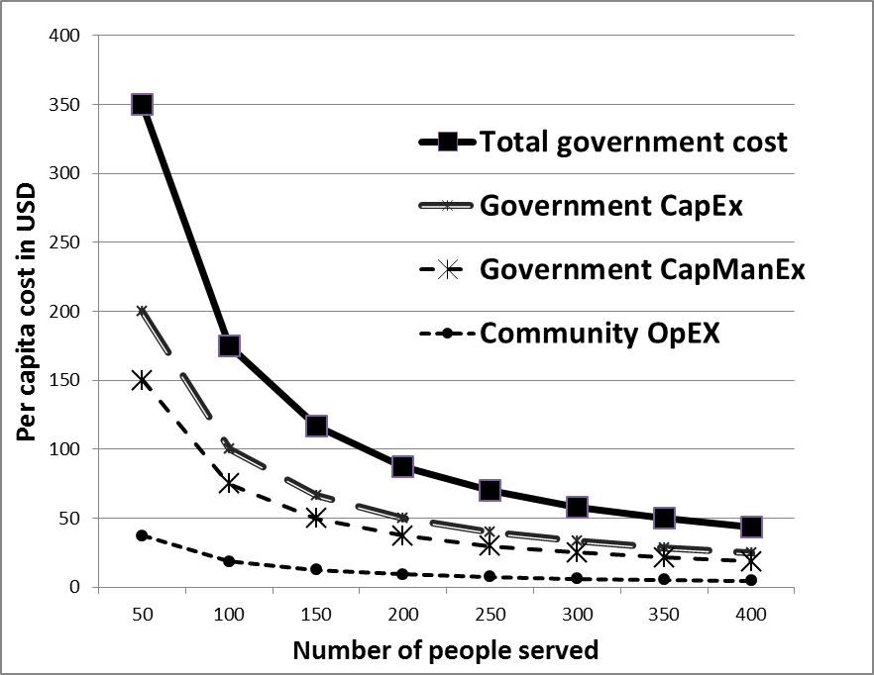
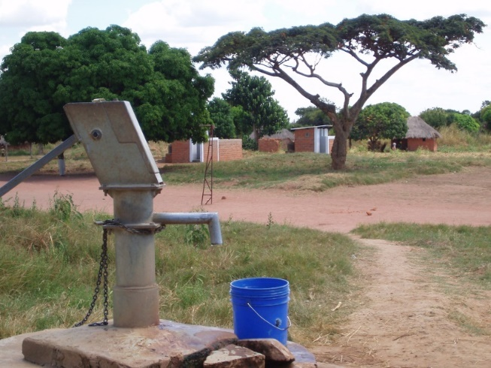
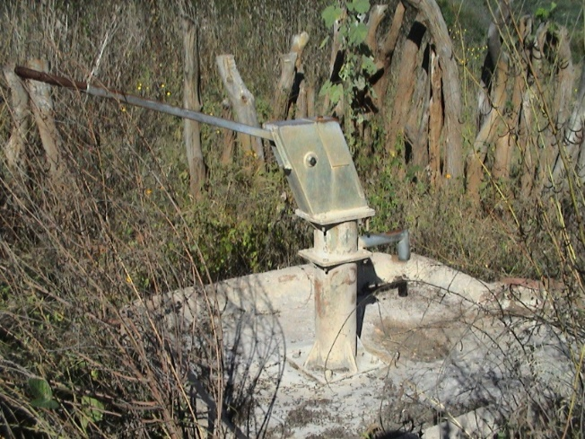
Per capita lifecycle costs to Government of handpump and borehole, Zambia

Slide 4
Population density in rural Zambia = 12/km²
in rural Zimbabwe = 26/km²

Slide 5
If the effects of small community size are included, the actual annual costs of providing community water supplies to 95% of the population rise by a factor nearer to ten times as much as in previous years.
Self-supply can be part of the solution:
households cover most (or all) of infrastructure costs;
demand-driven, convenient, affordable, productive;
household ownership (but shared with neighbours);
flexible (technology agnostic) and upgradable;
allows incremental investment.
Notes:
Key message:
The core principle behind Self-supply is allowing people to climb the water ladder according to their priorities and means.
Households can invest in incremental steps for improving own supplies and in improving water quality.
In rural areas often people still use open water sources. Through Self-supply they climb up ladder. Initially the first steps might not reach the “improved” level according to WHO/JMP standards, however little by little they climb higher. It is most likely that there is not sufficient funding to implement communal water supplies everywhere to move all people up the ladder from basic steps to higher, improved steps in one go.

Slide 6
Per capita costs for Government and communities with
Community Water Supplies (CWS) and Self-supply
Notes:
A cost effective additional option is supporting better self-supply over to Pete

Slide 7
Self-supply is a complementary strategy
(58% in Zimbabwe)
Achieving universal access in rural areas by communal water systems alone is just not feasible as much too costly!
Only a blended approach including supported Self-supply will make this possible.
7
Notes:
If a blended approach is followed to achieve universal access, total LCC costs can be reduced by about 48% which is equal to about US$ 330 million.
For every 1 US$ invested by government in supported Self- supply, about 2-3 US$ investments are leveraged by households.
Achieving universal access following communal supply approaches alone, is just not feasible and affordable! The only realistic approach to achieve SDG in rural areas is by following a blended approach which includes supported Self-supply.

Slide 8
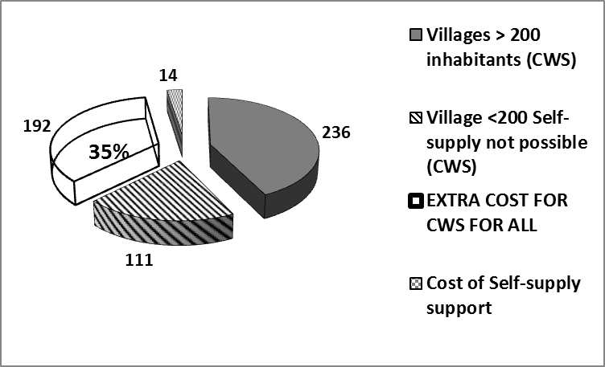
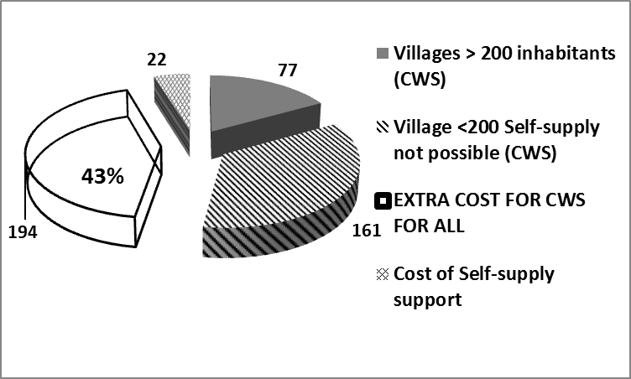
Savings to Government
There are significant operational challenges to scaling up Self-supply but the advantages clearly outweigh these.
Zambia: Government costs to reach universal access with CWS (Total $553 million) and savings with Self-supply. Costs in million US$ |  | Zimbabwe: Government costs to reach universal access with CWS (Total $455 million) and savings with Self-supply. Costs in million US$
Household subsidies are an option but only if the money is there!
Micro-credit schemes can help accelerate access.

Slide 9

Conclusions
Self-supply is a cost-effective auxiliary solution to community water supply, which will result in enormous savings in reaching small rural communities and scattered households.
Governments must rapidly adapt water supply strategies to ensure that Self-supply is incorporated into long-term SDG planning. Zimbabwe shows that getting the concept absorbed into government strategy and family mentality takes time to develop to the most cost effective level.
Supported Self-supply already contributes a third of rural coverage, but has potential to increase by the same amount again (21% of population is already using now but this could be nearer 40%).
The resources of households provide a largely untapped resource in expanding access to safe water and given that the poorest households commonly use their neighbours’ improved sources free-of-charge, Self-supply automatically leads to more equitable access to affordable drinking water.

Slide 10
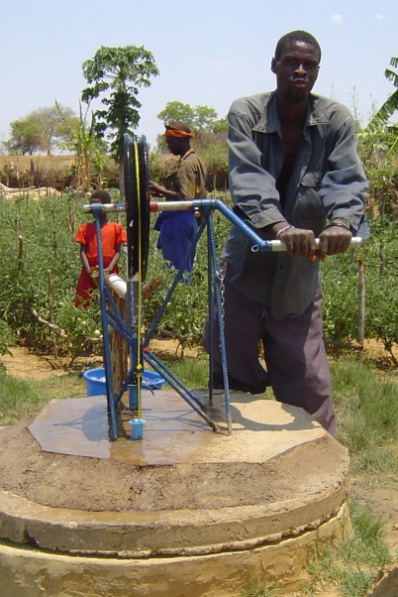
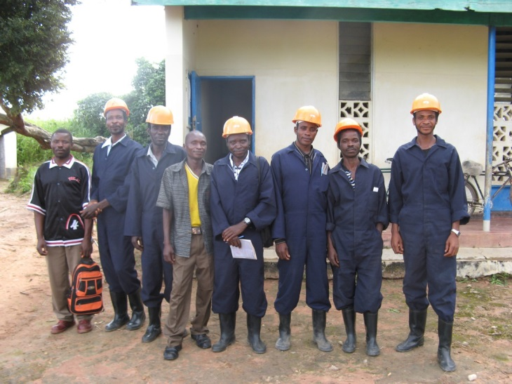
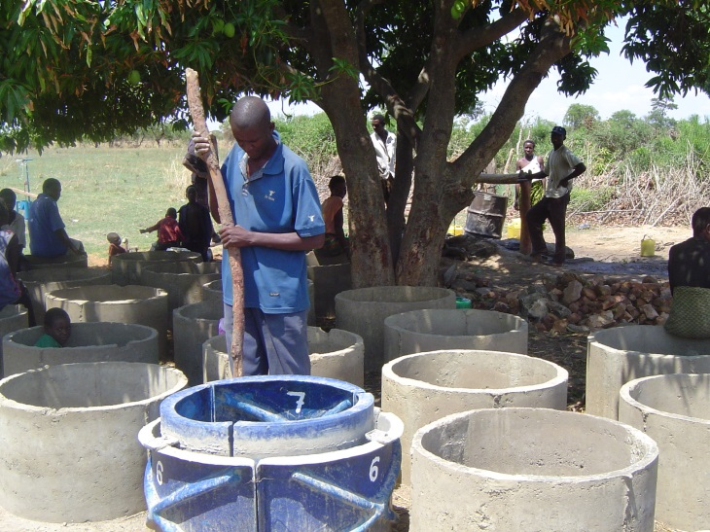
Thank You

